Slide 1

Esports Betting Network
Matthew Hill
19.11.2020

Slide 2

ESBN PRIMER
INTRODUCTION
RESEARCH
TARGET AUDIENCE
TECHNICAL ASPECTS
CONCERNS
CLOSING

Slide 3
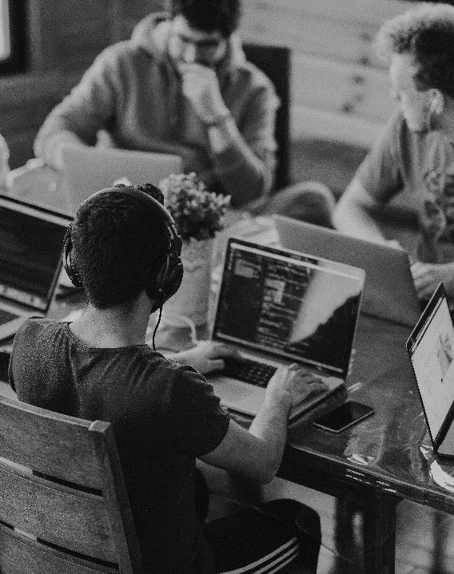
INTRODUCTION to ESBN
ABOUT ME
I am a third-year student at Victoria University, working towards a Bachelor of Science, with a specialization in artificial intelligence.
My domains of interest are Software Development and Artificial Intelligence, primarily focused on deep neural networks.
Throughout my life I have been involved in various esports scenes, namely StarCraft2, League of Legends and StarCraft: Brood War.
One of my long-term goals is research into using machine learning as a supplementary practice tool for professional gamers.

Slide 4
INTRODUCTION to ESBN
WHAT IS IT?
Esports Betting Network (ESBN) is a smart contract built on the Ethereum network which aims to provide a trustless system to enable peer-to-peer betting on your favourite esports.
We aim to provide coverage for both professional matches, and live streamed matches of professional and non-professional gamers.
As opposed to traditional betting systems where the house takes a significant portion, we instead aim to provide lower fees,

Slide 5
INTRODUCTION to ESBN
WHY BLOCKCHAIN?
By utilizing smart contracts and publicly available information of match results we can provide instantaneous and automatically realized payouts.
The peer-to-peer nature allows us to let the market decide the odds, which alleviates the risk associated with taking bets, and in turn allows us to offer far better payout odds to our clients.

Slide 6

ESPORTS AT A GLANCE
Let’s Dive In

Slide 7

ESPORTS AT A GLANCE
WHY ARE WE INTERESTED?
The esports industry is growing at a great pace, with a large proportion of the younger populations being interested, and both audience growth and global revenue increasing.
With this fledgling market as well as seeing great growth is now beginning to introducing new innovative revenue streams such as streaming and digital goods.

Slide 8
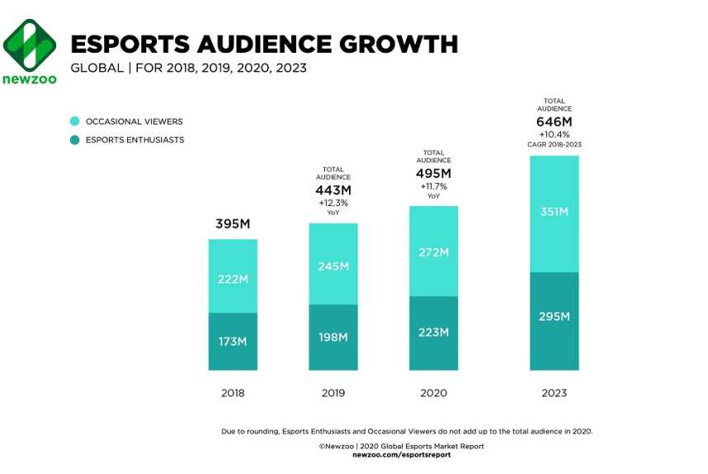
ESPORTS ARE GROWING QUICKLY

Slide 9
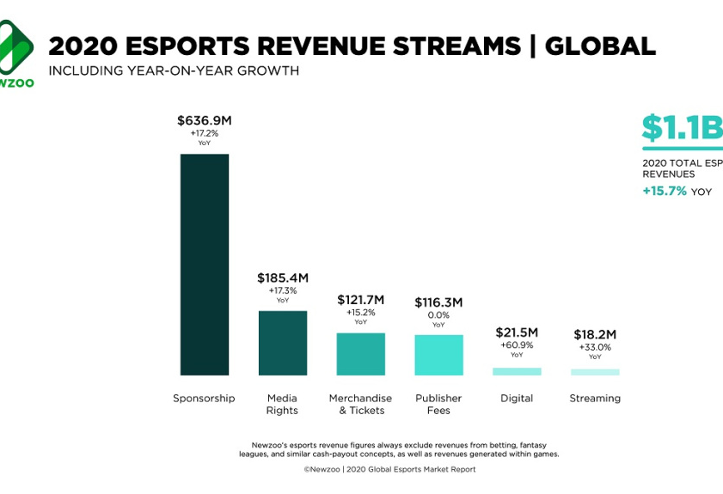
ESPORTS ARE GROWING QUICKLY

Slide 10
TARGET AUDIENCE
WHO ARE THE FANS?
Esports fans are typically young, and deeply engaged, with large average watching times. Research shows that fans are predominately male millennials although there is still a strong female presence of 38%.
Surveys found that 43% of esports enthusiast have an annual household income of $110k or higher and 31% have an income of $130k or higher.
This shows that esports fans in general are working professionals with a strong global purchasing power.

Slide 11
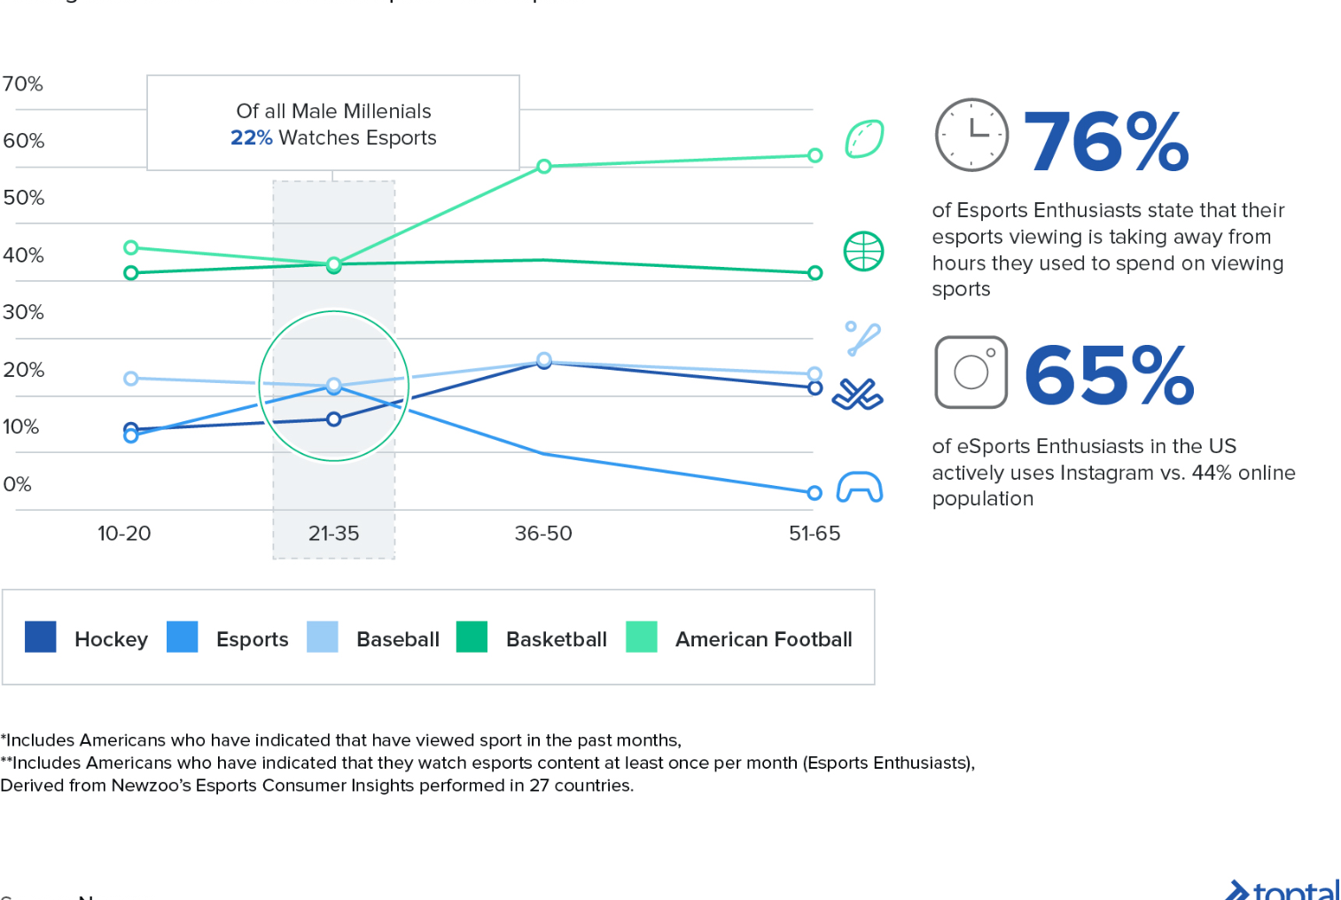
ESPORTS ARE GROWING QUICKLY

Slide 12
TARGET AUDIENCE
OUR AUDIENCE
Our target audience are those working professionals who are heavily invested in esports, who are financially stable, and who want to heighten the excitement of watching esports by putting money on the line in a safe manner.

Slide 13

TECHNICAL ASPECTS
We aim to provide a smart contract in which people can deposit Ethereum and bet on the outcome of esports matches.
Instead of calculating risk and creating odds which are in our favor, the market itself will determine the odds, allowing us to offer better odds than traditional bookie systems, while retaining peace of mind that comes with said systems.

Slide 14
TECHNICAL ASPECTS
We suggest a low fee on all bets, such as 1%, which we will use to pay the Ethereum gas price, and any business overheads.
The rest will then be distributed evenly between an approved charity such as the Problem Gambling Foundation, and the governing entity the bet revolves around, such as a streamer or tournament organizer.
This both provides incentive to support the ESBN system and benefits the community.

Slide 15
TECHNICAL ASPECTS
While this system can theoretically work for any esport, it would ideally be implemented for those with a readily available public record of match results that we can use to verify the results of matches and automatically release funds to the winners.
One example of a resource we could pull from is the League of Legends resource OP.GG which contains an automatically updating public ledger of match results.

Slide 16
TECHNICAL ASPECTS
The betting process would begin, either by website or by a bot implemented in a livestream channel.
Anyone with appropriate funds would be able to deposit money into the smart contract along with their prediction.
Given enough users the market would automatically adjust to the odds to an appropriate amount, and after a certain amount of time, bets would be unable to be added for the match.
Once the match’s result is uploaded to the queried website the funds that are held by the smart contract would be released to the winners minus the small fee.

Slide 17

CONCERNS
LOOKING AHEAD

Slide 18
POTENTIAL CONCERNS
ETHICS
While the system itself is benign many people in the world do struggle with gambling addictions, and this could be a potential enabler for them.
Also, due to the nature of gambling traditionally being restricted to those of a certain age, this system could potentially be used to circumvent that, as there is no way to verify the user.
This also opens potential problems with match fixing which esports has had scandals in the past with, and streamers would be highly susceptible as they would be playing many low stake games daily which would be almost imperceivable if they were being fixed.

Slide 19
POTENTIAL CONCERNS
LEGALITY
While esports betting is legal in many countries, including New Zealand, this is not the case in all, thus we would potentially be providing an illegal service to denizens of said countries.
If we were to enforce strict limitations on either origins or age, there is nothing to stop a person purchasing a verified account and using it as their own.
Currently New Zealand has a well defined and well-regulated gambling industry, and although it is legal to bet on esports local operators are unable provide “remote interactive gambling” services.

Slide 20
POTENTIAL CONCERNS
POTENTIAL SOLUTIONS
Although there is now way to prevent those with gambling problems from partaking in our services, we can take a similar approach as the New Zealand government, by taking a portion of the funds raised and directing them to appropriate charities, such as the Problem Gambling Foundation.
As for the legality of the project, this would likely need thorough investigation into the current laws, and future law surrounding both gambling, and decentralized autonomous organizations, of not just New Zealand but the entire world.
Thus we will likely need large funding and a strong legal team to implement a full-scale version, as well as flexibility as laws change worldwide.

Slide 21

SUMMARY
SAFE PEER-TO-PEER ESPORTS BETTING
We aim to provide better odds for our clients and utilize the fees gathered to give back to the community.
ESPORTS IS A GROWING MARKET
We aim to provide additional entertainment for financially stable esports enthusiasts.
WE NEED TO REMAIN FLEXIBLE
Regulations around gambling, and decentralized autonomous organizations differ worldwide and are seeing drastic changes.

Slide 22



THANK YOU
MATTHEW HILL
027 69 69 979
matthillwakatipu@gmail.com

